Slide 1
Usability Evaluation of Language Learning Software for Users – Proposal Presentation
Christopher Jones
I7467340
26/10/18

Slide 2




Case Study/Problem Overview
Difference in languages → One of the largest cultural barriers that people face around the world.
According to EuroStats, only 34.6% of UK citizens can speak multiple languages – Showing the language learning methods can be improved.
There are thousands of platforms that assist users with learning new languages → Vary in features (Free/Paid Subscription, Mobile/Desktop/Tablet, Visual/Audio)
The challenge is to design a reliable product for users of all skill levels to use on a daily basis → Showing no UX issues

Slide 3
Aim and Objectives
AIM: Analyse one of the most popular language learning platforms around. Applying Human Factors approaches to find out how the product usability can improve.
OBJECTIVES:
Assess whether a Language Learning App is the most optimum method with assisting users with learning new languages– Any other methods that are better?
Apply Soft Systems Methodology to analyse the problem in a real world situation – Which platform is best for this product?
Analyse the UX techniques and conduct accessibility tests - Evaluate the systems in the perspective of a new users
Reflect on industrial case studies → Gain further understanding with the system

Slide 4
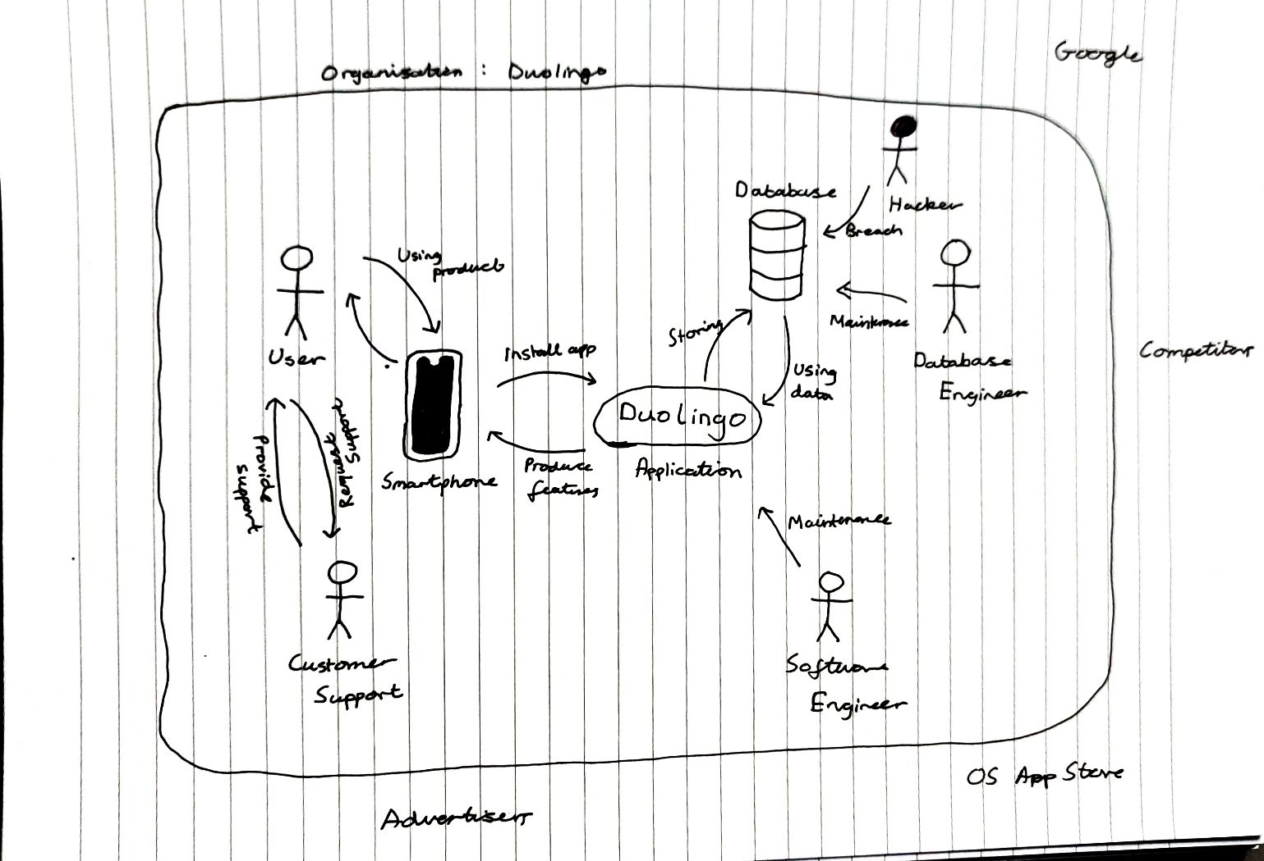
Rich Picture

Slide 5
Proposed Techniques
Soft Systems Methodology – Containing a rich picture, rich definitions and conceptual models. Can increase the understanding of a problem through investigation. Also helps identify areas that need to be improved.
User-Centred Design – Focusing on the users and their needs in each phase of the design process. Employing a mixture of investigative methods and tools to gain further understanding.
Usability Evaluation – How well users can learn and use the product to achieve their goals. This will include hosting Heuristic Evaluations and Interviews

